Slide 1

Misagh Mohaghegh Mohammad GharehHasanloo
Lab Project 2:
System Calls and Processes

Slide 2
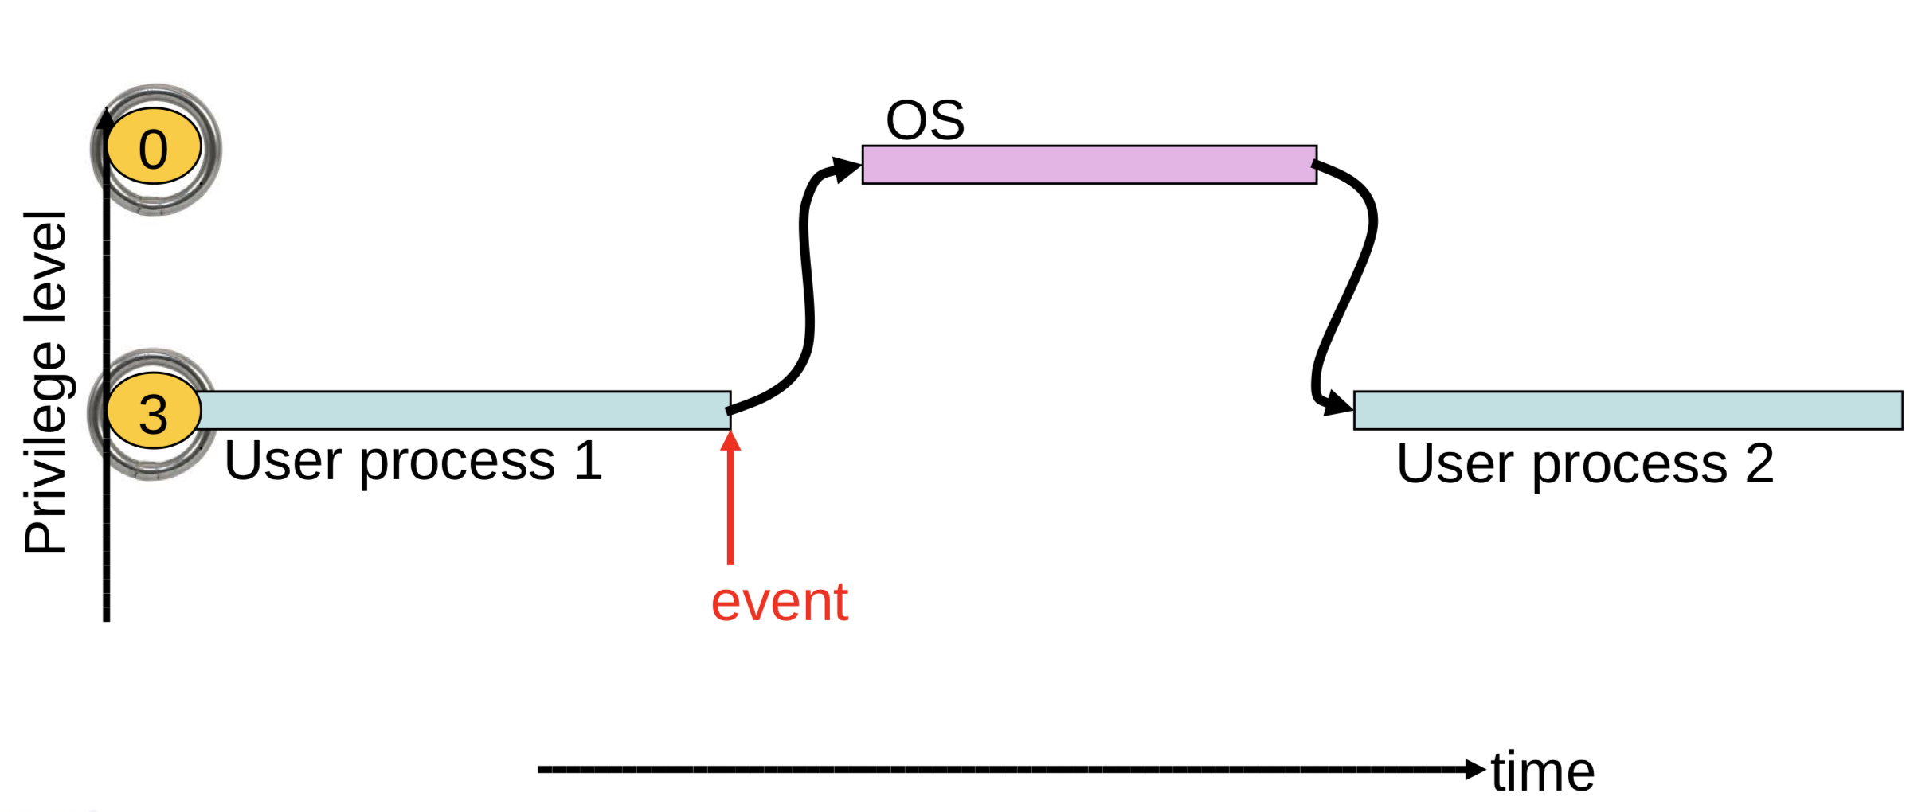
Why Event Driven Design?
OS cannot trust user processes
User processes may be buggy or malicious
User process crash should not affect OS
OS needs to guarantee fairness to all user processes
One process cannot 'hog' CPU time
Timer interrupts

Slide 3
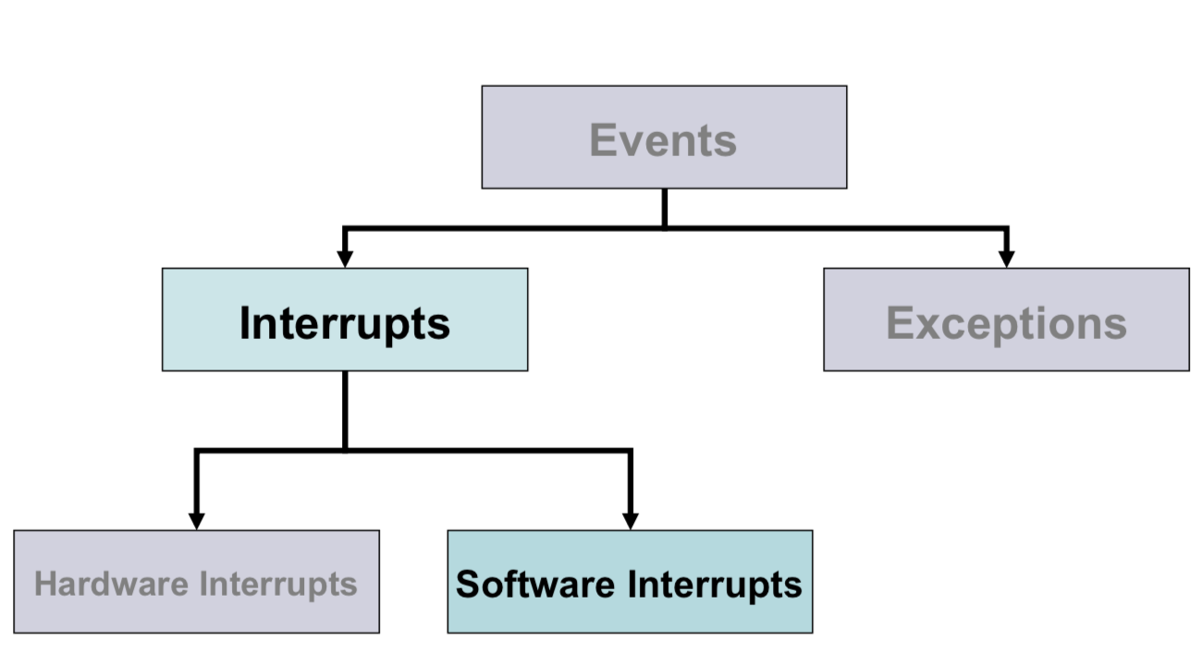
System Calls

Slide 4
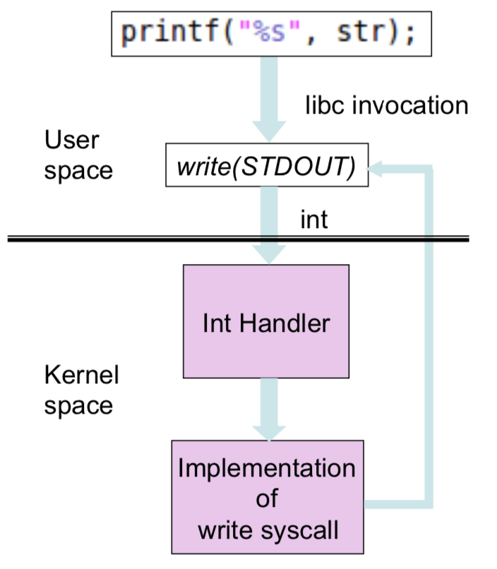
Write System Call

Slide 5
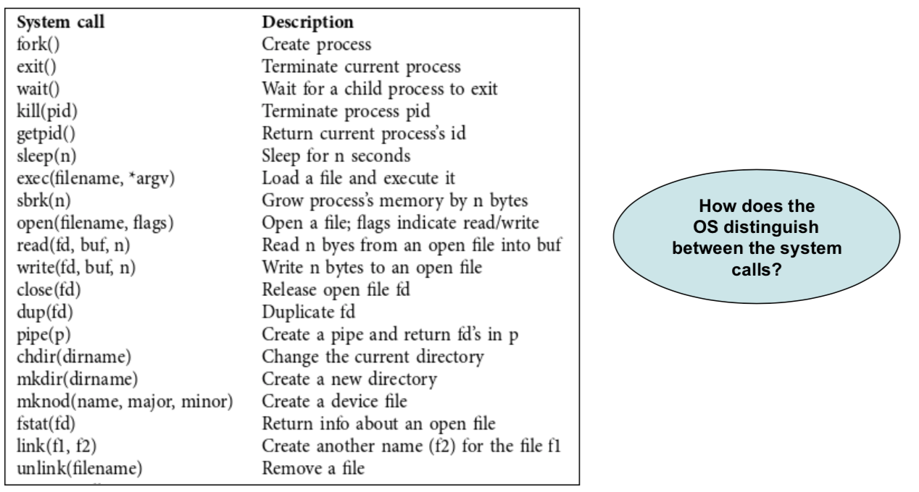
System Calls in xv6

Slide 6
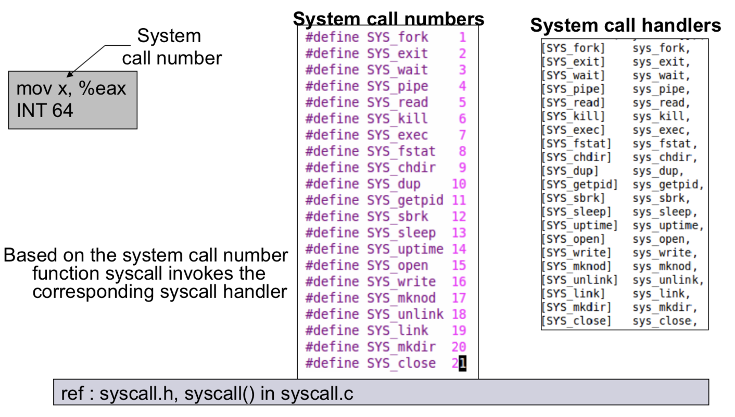
System Call Number

Slide 7
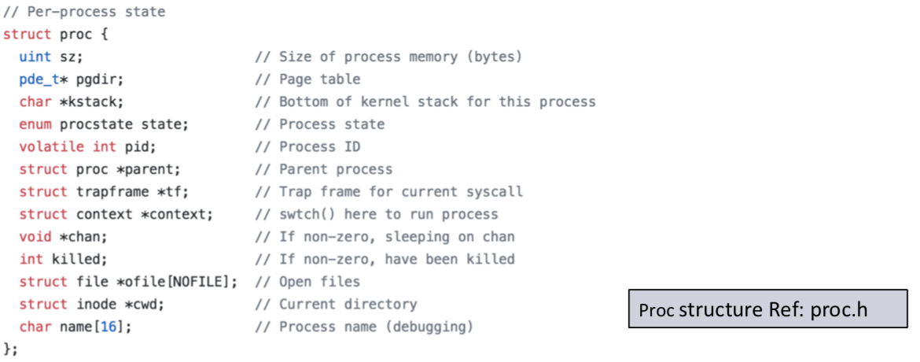
Processes
Processes are created by the kernel, after another process asks it to. Therefore, the kernel needs to run the first process itself, in order to create someone who will ask for new processes to be created.

Slide 8
Passing Parameters in System Calls
Passing parameters to system calls not similar to passing parameters in function calls
Recall stack changes from user mode stack to kernel stack.
Typical Methods
Pass by Registers (eg. Linux)
Pass via user mode stack (eg. xv6)
Complex
Pass via a designated memory region
Address passed through registers

Slide 9
find_digital_root
int find_digital_root(int n)
Calculate the digital root of the input number. For instance, if the input number is 284, you should print the number 5 in the output.
It's important to use registers to store the argument value, not for the address location. Additionally, after executing the system call, the unchanged value of the register should be preserved.
Test:
Call this system call with different parameters and display results

Slide 10
copy_file
int copy_file(const char* src, const char* dest)
This system call takes two file names as input and copies the file with the first name to the location specified by the second name. It returns 0 on success, otherwise -1.
Test:
Write a user-level program and call the system call as described. Display the result of the copy operation.

Slide 11
get_uncle_count
int get_uncle_count(int)
Return the number of uncles of a process. An uncle process refers to the siblings of the parent process
Test:
Create three child processes. Then, create an additional child for one of them
Finally, use the system call for the specific process and display the output

Slide 12
get_process_lifetime
int get_process_lifetime(int)
Calculate the lifespan of a process from its creation to the time this system call is called.
Test:
Create a child process and terminate it after 10 seconds
Display the lifespans of both the child and the parent processes

